Slide 1
5th & 6th Grade RAISING AWARENESS - ADVISORY PROJECT

Slide 2
Expectations
Each 5th and 6th Grade Advisory is to:
Decide on a Cause
Research that Cause
Decide how they will spread awareness (pick a strategy.)
Create something tangible they will use to spread awareness during Segue’s Awareness Month
Submit idea before the portfolio deadline (11/14)
Show up! Be ready during Awareness Month to spread information on your cause to raise awareness.

Slide 3
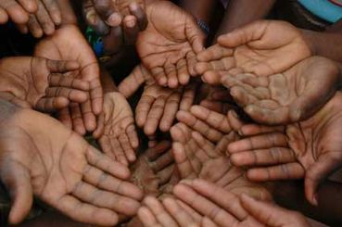
List of Causes (these are just ideas-feel free to venture out.)
Access to Quality Education
Protecting Animals
Global Warming
Racial Ethnic and Cultural Inclusiveness
Increasing access to Technology
Increasing Access to Clean Water
Reducing Child Mortality
Gender Equality and Empowering Women
Spreading Kindness
School Safety
Syrian Refugee Crisis
Undocumented Rights
Poverty and Hunger
Health (allergies, cancer, Alzheimer's, drug overdose)

Slide 4
Ways to Raise and Spread Awareness for your Cause
Host a Live Educational Event
Make a Press Release
Give Free Advice Relating to your Cause
Have a Contest (Ice Bucket Challenge)
Make some Merchandise (Upstander Pins)
Create a Brochure/Pamphlet
Host a Contest
Organize a Service Project (Allow groups (e.g., service clubs, employees at a company, etc.) to volunteer together in some way related to your work, perhaps on a special volunteer day.
Boost Social Media Awareness (kindness challenge)
Create a PSA (Teach Me how to Brushy https://youtu.be/5ugQLL65BKc)
Create a Campaign

Slide 5
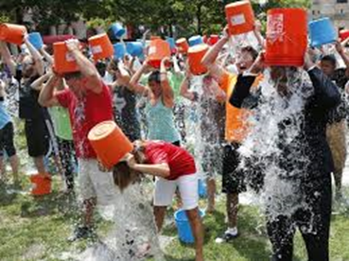
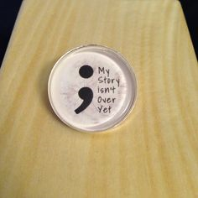
INSPIRATION

Slide 6
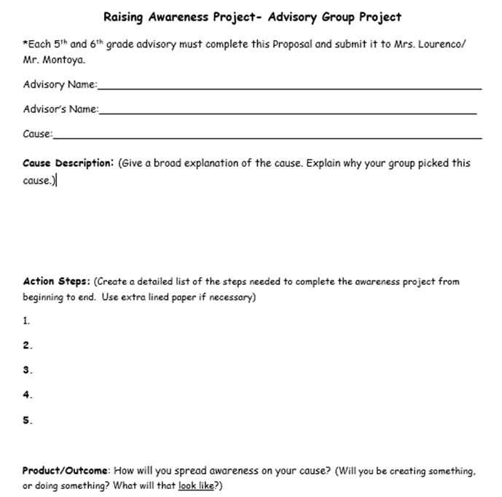
GET APPROVAL

Slide 7
Reflect
Advisory Awareness Project Reflection Questions
1.Describe what you did for your Awareness project. Why did your advisory choose this cause? (3-5 sentences)
2. Describe your experience working with your advisory on this project (3-5 sentences)
3. Do you feel your group was successful in raising awareness on your cause? (3-5 sentences)

